Slide 1
Chapter 2
Recognizing Opportunities and Generating Ideas
2-<number>

Slide 2
Chapter Objectives
1 of 3
Explain why it’s important to start a new firm when its “window of opportunity” is open.
Explain the difference between an opportunity and an idea.
Describe the three general approaches entrepreneurs use to identify opportunities.
Identify the four environmental trends that are most instrumental in creating business opportunities.
List the personal characteristics that make some people better at recognizing business opportunities than others.
3-<number>

Slide 3
Chapter Objectives
2 of 2
Identify the five steps in the creative process.
Describe the purpose of brainstorming and its use as an idea generator.
Describe how to use library and Internet research to generate new business ideas.
Explain the purpose of maintaining an idea bank.
Describe three steps for protecting ideas from being lost or stolen.
2-<number>

Slide 4

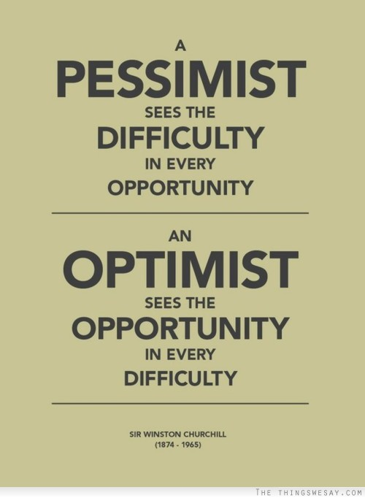


2-<number>

Slide 5
What is An Opportunity?
1 of 2
An opportunity is a favorable
set of circumstances that
creates a need for a new
product, service or business.
Opportunity Defined
2-<number>

Slide 6
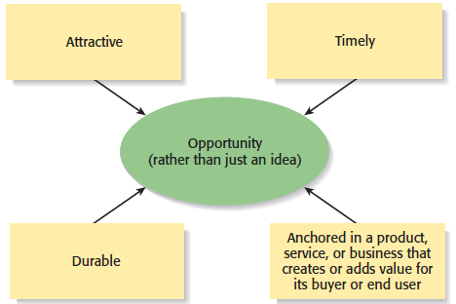
What is an Opportunity?
2 of 2
An opportunity has four essential qualities
2-<number>

Slide 7

Three Ways to Identify an Opportunity
2-<number>

Slide 8
First Approach: Observing Trends
1 of 2
Observing Trends
  Trends create opportunities for entrepreneurs to pursue.
  The most important trends are:
    Economic forces.
    Social forces.
    Technological advances.
    Political action and regulatory change.
  It’s important to be aware of changes in these areas.
2-<number>

Slide 9
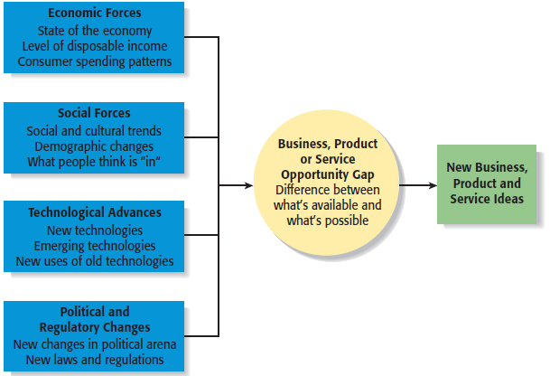
First Approach: Observing Trends
2 of 2
Environmental Trends Suggesting Business or Product Opportunity Gaps
2-<number>

Slide 10
Trend 1: Economic Forces
Example of Economic Trend Creating a Favorable Opportunity
Economic trends help determine areas that are ripe for new startups and areas that startups should avoid.
A weak economy favors
startups that help consumers
save money.
An example is GasBuddy.com,
a company started to help
consumers save money on gas.
2-<number>

Slide 11
Trend 2: Social Forces
Examples of Social Trends
Social trends alter how people and businesses behave and set their priorities. These trends provide opportunities for new businesses to accommodate the changes.
Retirement of baby boomers.
The increasing diversity of
the workplace.
Increasing interest in health,
fitness, and wellness.
Emphasis on alternative forms
of energy.
New forms of music and other
types of entertainment.
2-<number>

Slide 12
Trend 3: Technological Advances
1 of 2
Examples of Entire Industries that Have Been Created as the Results of Technological Advances
Advances in technology frequently create business opportunities.
Computer industry
Internet
Biotechnology
Digital photography
2-<number>

Slide 13
Trend 3: Technological Advances
2 of 2
Example: H20Audio
Once a technology is created, products often emerge to advance it.
An example is H20Audio, a company started by four former San Diego State University students, that makes waterproof housings for the Apple iPod.
2-<number>

Slide 14
Trend 4: Political Action and Regulatory Changes
1 of 2
General Example
Political action and regulatory changes also provide the basis for opportunities.
Laws to protect the environment have created opportunities for entrepreneurs to start firms that help other firms comply with environmental laws and regulations.
2-<number>

Slide 15
Second Approach: Solving a Problem
1 of 2
Solving a Problem
  Sometimes identifying opportunities simply involves noticing a problem and finding a way to solve it.
  These problems can be pinpointed through observing trends and through more simple means, such as intuition, serendipity, or change.
2-<number>

Slide 16

Second Approach: Solving a Problem
2 of 2
A problem facing the U.S. and
other countries is finding
alternatives to fossil fuels.
A large number of
entrepreneurial firms, like
this wind farm, are being
launched to solve this problem.
2-<number>

Slide 17
Third Approach: Finding Gaps in the Marketplace
1 of 2
Gaps in the Marketplace
  A third approach to identifying opportunities is to find a gap in the marketplace
  A gap in the marketplace is often created when a product or service is needed by a specific group of people but doesn’t represent a large enough market to be of interest to mainstream retailers or manufacturers.
2-<number>

Slide 18
Third Approach: Finding Gaps in the Marketplace
2 of 2
Specific Example
Product gaps in the marketplace represent potentially viable business opportunities.
In 2000 Tish Cirovolv realized there were no guitars on the market made specifically for women. To fill this gap, she started Daisy Rock Guitars, a company that makes guitars just for women.
2-<number>

Slide 19
Personal Characteristics of the Entrepreneur
Characteristics that tend to make some people better at recognizing opportunities than others
Prior Experience
Cognitive Factors
Social Networks
Creativity
2-<number>

Slide 20
Prior Experience
Prior Industry Experience
  Several studies have shown that prior experience in an industry helps an entrepreneur recognize business opportunities.
    By working in an industry, an individual may spot a market niche that is underserved.
    It is also possible that by working in an industry, an individual builds a network of social contacts who provide insights that lead to recognizing new opportunities.
2-<number>

Slide 21
Cognitive Factors
Cognitive Factors
  Studies have shown that opportunity recognition may be an innate skill or cognitive process.
  Some people believe that entrepreneurs have a “sixth sense” that allows them to see opportunities that others miss.
  This “sixth sense” is called entrepreneurial alertness, which is formally defined as the ability to notice things without engaging in deliberate search.
2-<number>

Slide 22
Social Networks
1 of 3
Social Networks
  The extent and depth of an individual’s social network affects opportunity recognition.
  People who build a substantial network of social and professional contacts will be exposed to more opportunities and ideas than people with sparse networks.
  In one survey of 65 start-ups, half the founders reported that they got their business idea through social contacts.
Strong Tie Vs. Weak Tie Relationships
  All of us have relationships with other people that are called “ties.” (See next slide.)
2-<number>

Slide 23
Social Networks
2 of 3
Nature of Strong-Tie Vs. Weak Tie Relationships
  Strong-tie relationship are characterized by frequent interaction and form between coworkers, friends, and spouses.
  Weak-tie relationships are characterized by infrequent interaction and form between casual acquaintances.
Result
  It is more likely that an entrepreneur will get new business ideas through weak-tie rather than strong-tie relationships. (See next slide.)
2-<number>

Slide 24
Social Networks
3 of 3
Why weak-tie relationships lead to more new business ideas than strong-tie relationships
Strong-Tie Relationships
Weak-Tie Relationships
These relationships, which typically form between like minded individuals, tend to reinforce insights and ideas that people already have.
These relationships, which form between casual acquaintances, are not as apt to be between like-minded individuals, so one person may say something to another that sparks a completely new idea.
2-<number>

Slide 25
Creativity
1 of 2
Creativity
  Creativity is the process of generating a novel or useful idea.
  Opportunity recognition may be, at least in part, a creative process.
  For an individual, the creative process can be broken down into five stages, as shown on the next slide.
2-<number>

Slide 26
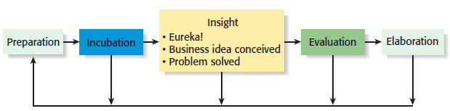
Creativity
2 of 2
Five-Steps to Generating Creative Ideas
2-<number>

Slide 27
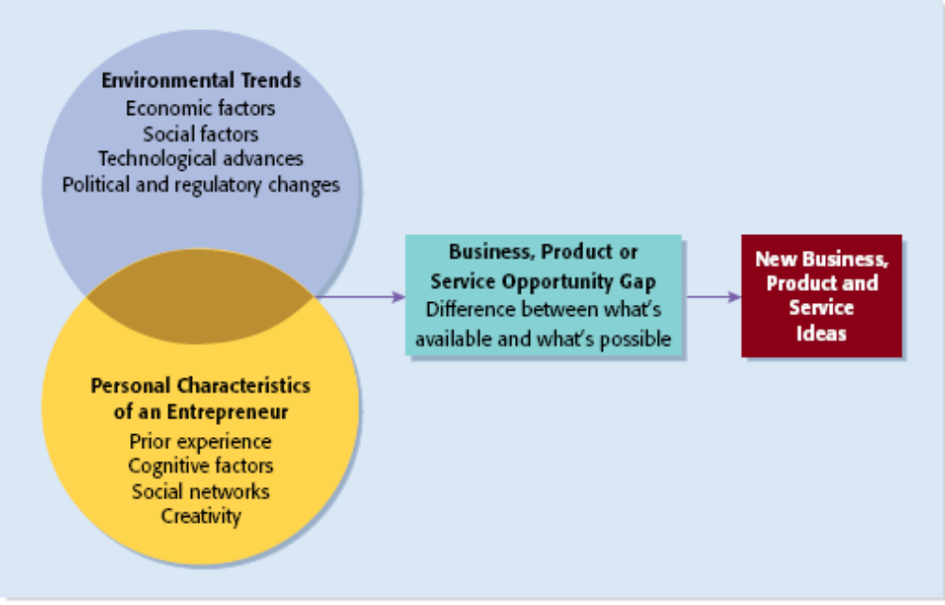
Full View of the Opportunity Recognition Process
Depicts the connection between an awareness of emerging trends and the personal characteristics of the entrepreneur
2-<number>

Slide 28
Techniques For Generating Ideas
Brainstorming
Focus Groups
Library and
Internet Research
2-<number>

Slide 29
Brainstorming
Brainstorming
  Is a technique used to generate a large number of ideas and solutions to problems quickly.
  A brainstorming “session” typically involves a group of people, and should be targeted to a specific topic.
  Rules for a brainstorming session:
    No criticism.
    Freewhelling is encouraged.
    The session should move quickly.
    Leap-frogging is encouraged.
2-<number>

Slide 30
Focus Groups
Focus Group
  A focus group is a gathering of five to ten people, who have been selected based on their common characteristics relative to the issues being discussed.
  These groups are led by a trained moderator, who uses the internal dynamics of the group environment to gain insight into why people feel they way they do about a particular issue.
  Although focus groups are used for a variety of purposes, they can be used to help generate new business ideas.
2-<number>

Slide 31
Library and Internet Research
1 of 3
Library Research
  Libraries are an often underutilized source of information for generating new business ideas.
  The best approach is to talk to a reference librarian, who can point out useful resources, such as industry-specific magazines, trade journals, and industry reports.
  Simply browsing through several issues of a trade journal or an industry report on a topic can spark new ideas.
2-<number>

Slide 32
Libraries and Internet Research
2 of 3
Examples of Useful Search Engines and Industry Reports
Large public and university libraries typically have access to search engines and industry reports that would cost thousands of dollars to access on your own.
Lexis-Nexis Academic
ProQuest
IBISWorld
Mintel
Standard & Poor’s Net
Advantage
2-<number>

Slide 33
Library and Internet Research
3 of 3
Internet Research
  If you are starting from scratch, simply typing “new business ideas” into a search engine will produce links to newspapers and magazine articles about the “hottest” new business ideas.
  If you have a specific topic in mind, setting up Google or Yahoo! e-mail alerts will provide you to links to a constant stream of newspaper articles, blog posts, and news releases about the topic.
  Targeted searches are also useful.
2-<number>

Slide 34
Other Techniques
Customer Advisory Boards
  Some companies set up customer advisory boards that meet regularly to discuss needs, wants, and problems that may lead to new ideas.
Day-In-The-Life Research
  A type of anthropological research, where the employees of a company spend a day with a customer.
2-<number>

Slide 35
Encouraging New Ideas
Establishing a Focal Point for Ideas
  Some firms meet the challenge of encouraging, collecting, and evaluating ideas by designating a specific person to screen and track them—for if its everybody’s job, it may be no one’s responsibility.
  Another approach is to establish an idea bank (or vault), which is a physical or digital repository for storing ideas.
Encouraging Creativity at the Firm Level
  Creativity is the raw material that goes into innovation and should be encouraged at the organizational and individual supervisory level.
2-<number>

Slide 36
Protecting Ideas From Being Lost or Stolen
Step 1
  The idea should be put in a tangible form such as entered into a physical idea logbook or saved on a computer disk, and the date the idea was first thought of should be entered.
Step 2
  The idea should be secured. This may seem like an obvious step, but is often overlooked.
Step 3
  Avoid making an inadvertent or voluntary disclosure of an idea, in a manner that forfeits the right to claim exclusive rights to it.
2-<number>

